Slide 1
IBM Data Science Capstone
Author: Settara Pramod

Slide 2
Contents
Executive Summary
Introduction
Methodology
Results
Conclusion

Slide 3
Executive Summary
Summary of Methodologies:
Data Collection
Data Wrangling
Exploratory Data Analysis with Visualization
Exploratory Data Analysis with SQL
Visual Analytics with Folium
Dashboard with Dash
Predictive Analysis working

Slide 4
Executive Summary
Summary of Results:
EDA Findings
Prediction through Support vector machine, Classification Tree & Logistics Regression
For SVM sigmoid kernel provides better result on validation dataset
Hyper parameters for decision tree classifier through validation data

Slide 5
Introduction
The spaceX advertises the launch of Falcon 9 rocket through their website, it has a cost of 62 million USD, whereas the other providers cost are 165 million USD each, the main reason of the savings of spaceX is because that it can be reused the first stage We can determine the cost of the launch if we are determining that spaceX first stage will land The extracted information can be used for other companies who are interested to bid spaceX for launch of the rocket. We will be predicting that either spaceX first stage would be successfully be landed or not

Slide 6
Methodology
Data collection methodology
Data Wrangling
Exploratory Data Analysis (EDA) using visualization and SQL
Interactive Visual Analytics using Folium and Plotly
Predictive Analysis using classification models

Slide 7
Methodology
Data collection methodology
SpaceX Rest API
Web Scrapping Wikipedia
Data Wrangling
Hot encoding data fields and dropping irrelevant columns

Slide 8
Methodology
Exploratory Data Analysis (EDA) using visualization and SQL
Scatter/bar graphs
Predictive Analysis using classification models
Classification models

Slide 9
Data Collection Methodology
Data Collection Via Spacex API
Get response from API
Convert to json file
Clean Data
Convert to Dataframe
Filter & export as file

Slide 10
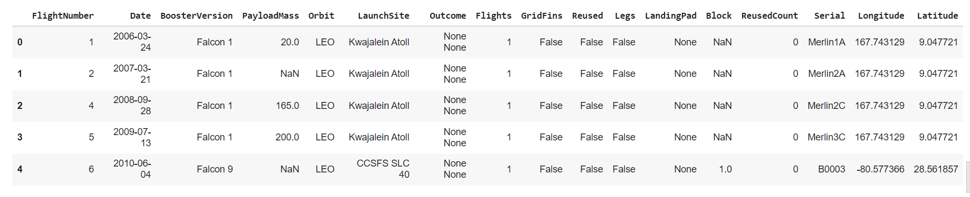
Data Collection Methodology
Data Collection Via Spacex API

Slide 11
Data Collection Methodology
Data Collection Via Web Scraping
Get response from HTML
Create a Soup Object
Find Tables
Get columns names
Create Dict & append data to key
Convert Dict to data frame
Export as CSV

Slide 12
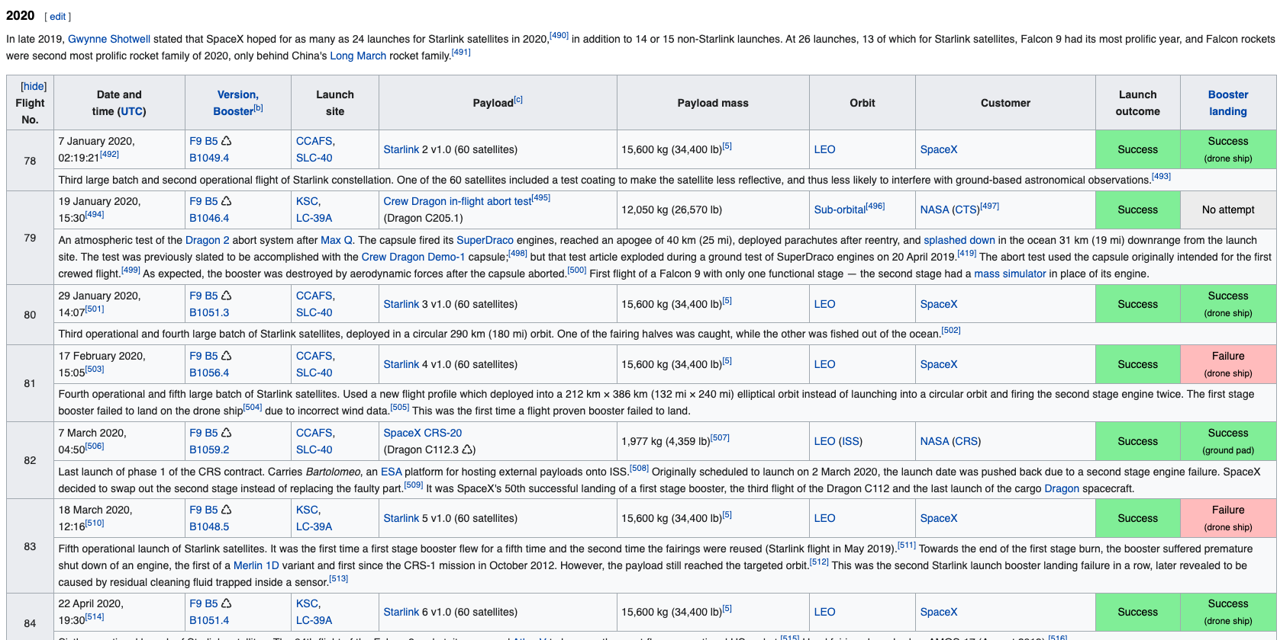
Data Collection Methodology
Data Collection Via Web Scraping

Slide 13
Data Wrangling
Calculate number of launches at each site
Calculate number and occurrence of each orbit
Calculate number and occurrence of mission outcome per orbit type
Create landing outcome label from Outcome column
Create dictionary and append data to keys
Export as .CSV file

Slide 14
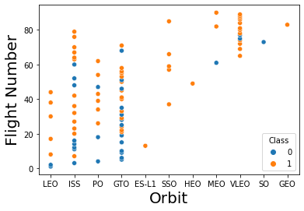
EDA Using Visualization And SQL
Scatter graph: to determine whether there is a noticeable dependency between the attributes

Slide 15
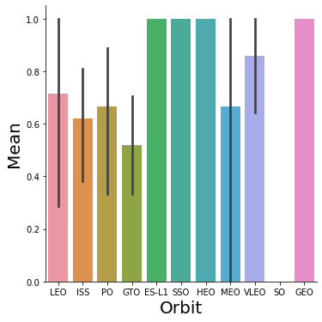
EDA Using Visualization And SQL
Bar graph: to help identify any visual trends or relationships

Slide 16
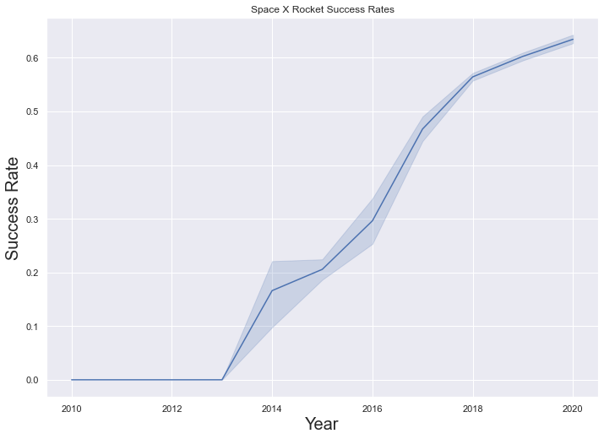
EDA Using Visualization And SQL
Line graph: helps to track the direct relationship and pattern between the data point

Slide 17
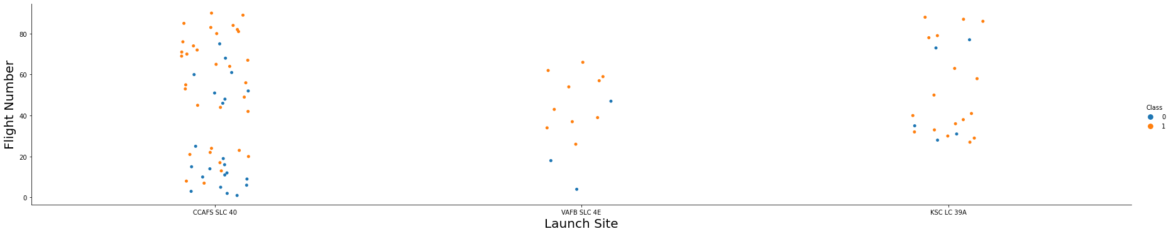
EDA Using Visualization And SQL
Flight Number Vs. Launch Site
With higher flight numbers (> 30), the success rate increases

Slide 18
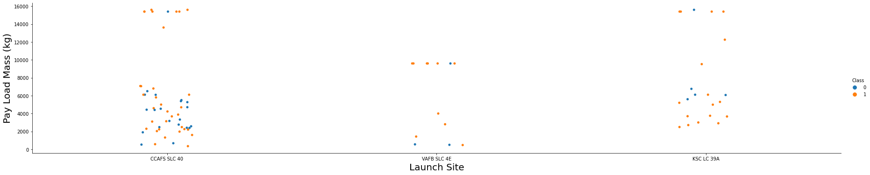
EDA Using Visualization And SQL
Payload Vs Launch Site
With greater payload mass (> 7000 KG), the higher the success rate for the rocket but payload mass and launch site are not directly correlated

Slide 19
EDA Using Visualization And SQL
Flight Number Vs Orbit Type
The LEO orbit had the highest success rate with a higher number of flights

Slide 20
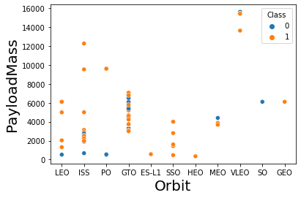
EDA Using Visualization And SQL
Payload Vs. Orbit Type
Higher payloads negatively impact the orbits

Slide 21
EDA Using Visualization And SQL
Launch Success Yearly Trend
Success rate since 2013 has increased consistently

Slide 22
EDA Using Visualization And SQL
Queries performed:
Display the names of the unique launch sites
Display 5 records where launch sites begin with the string ‘CCA’
Display total payload mass carried by boosters launched by NASA
Display average payload mass carried by booster version F9
List the date where the successful landing outcome in drone ship was achieved

Slide 23
EDA Using Visualization And SQL
Queries performed:
List the names of the boosters which have success in ground pad and have a payload mass greater than 4000 and less than 6000
List the total number of successful and failed mission outcomes
List the names of the booster versions which have carried the maximum payload mass
List the failed landing outcomes in drone ship, booster versions and launch site names in 2015
Rank the count of landing outcomes between 2010 and 2017

Slide 24
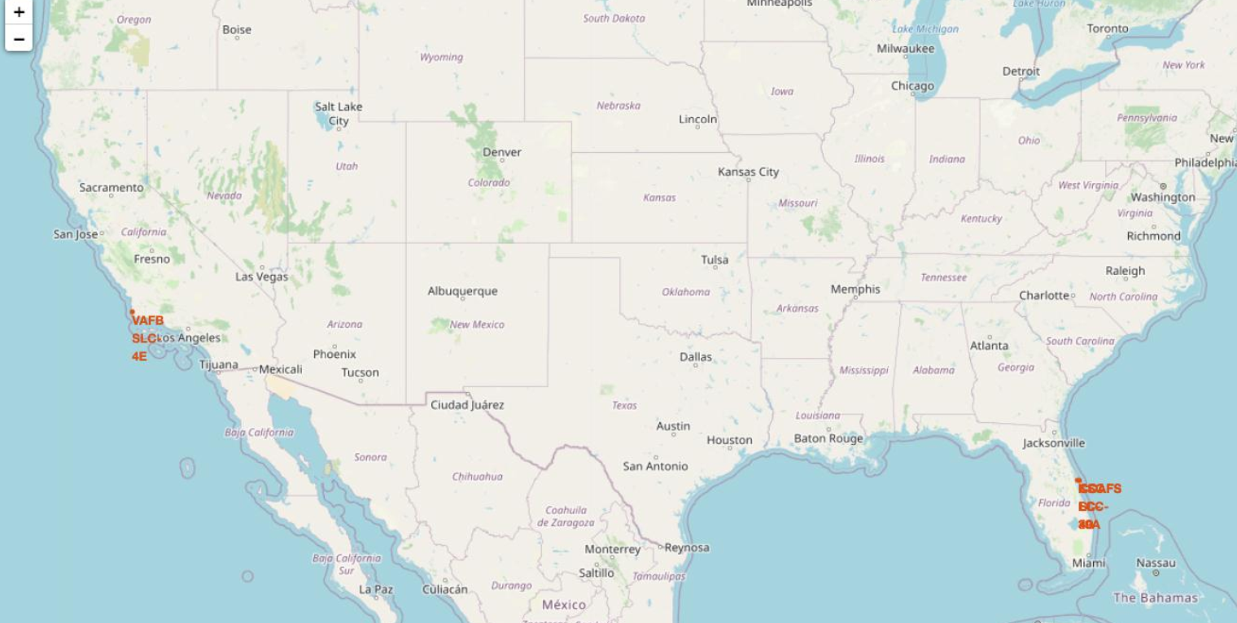
Interactive Visual Analytics using Folium and Plotly
All Launch Sites’ Location Markers On A Global Map

Slide 25
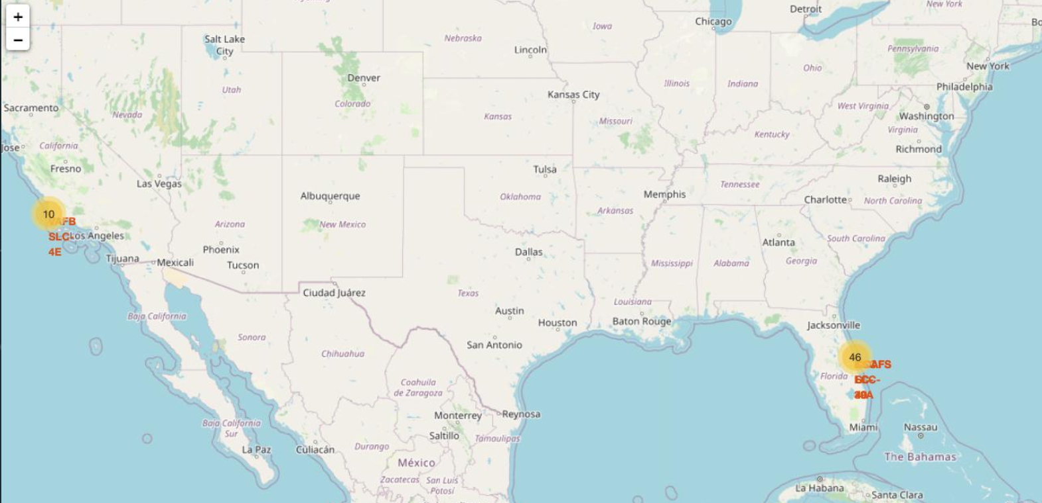
Interactive Visual Analytics using Folium and Plotly
The Success/Failed Launches For Each Site On The Map

Slide 26

Interactive Visual Analytics using Folium and Plotly
The Distances Between A Launch Site To Its Proximities

Slide 27
Predictive Analysis (Classification)
Built the model
Load the engineered data into a dataframe
Transform and standardize the data using Numpy
Split the data into training and test data sets
Check how many samples were created and set our parameters/algorithms
Fit the datasets into the GridSearchCV objects to train the model
Evaluating the model
Check the accuracy of the model and plot the Confusion Matrix
Finding the best performing classification model
Use the highest accuracy score

Slide 28
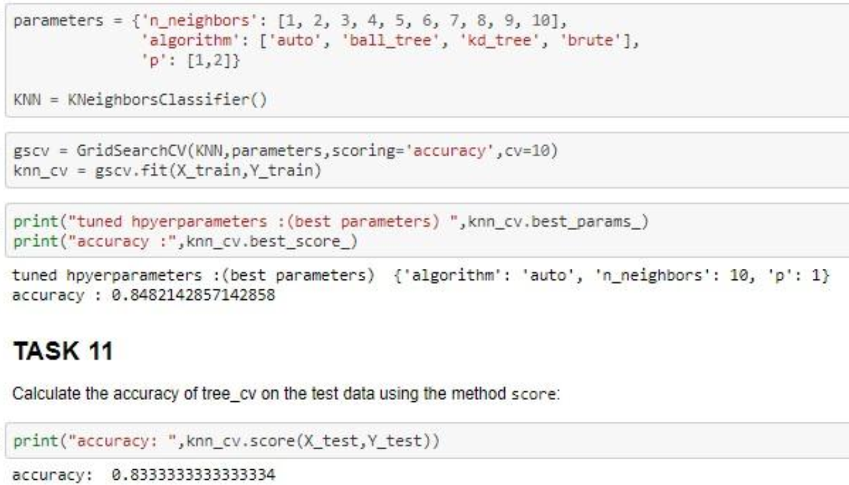
Results
KNN

Slide 29
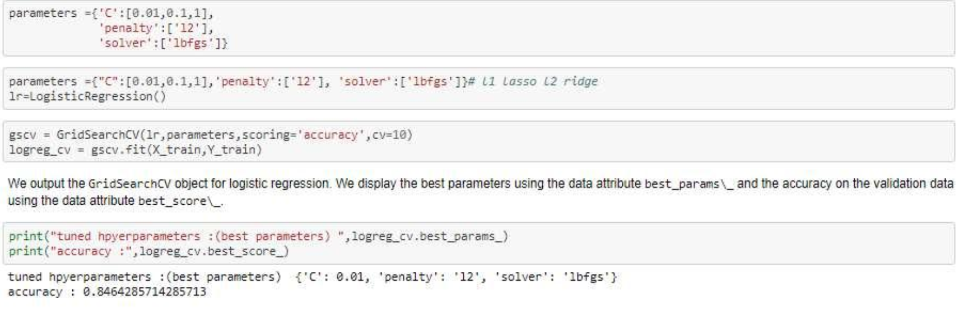
Results
Logistic Regression

Slide 30
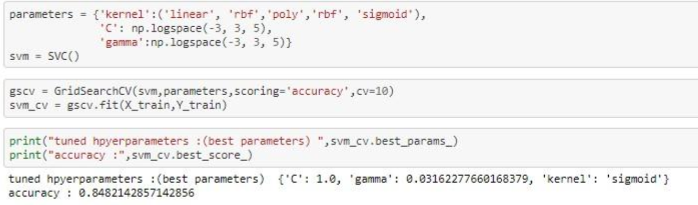
Results
SVM

Slide 31
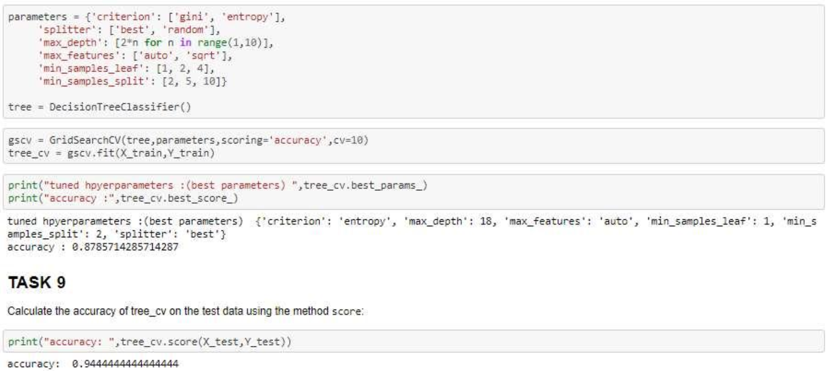
Results
Decision Tree

Slide 32
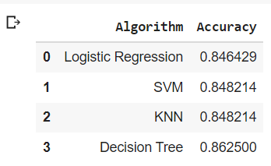
Accuracy

Slide 33
Conclusion
Number of launched success have increases over the years
ELS1, GEO, HEO, SSO have good success rate
KSCLC39 have best success rate.
Launch outcome impacted by the payload mass.
Accuracy is same on the test model
Decision tree classifier has highest accuracy

